Slide 1
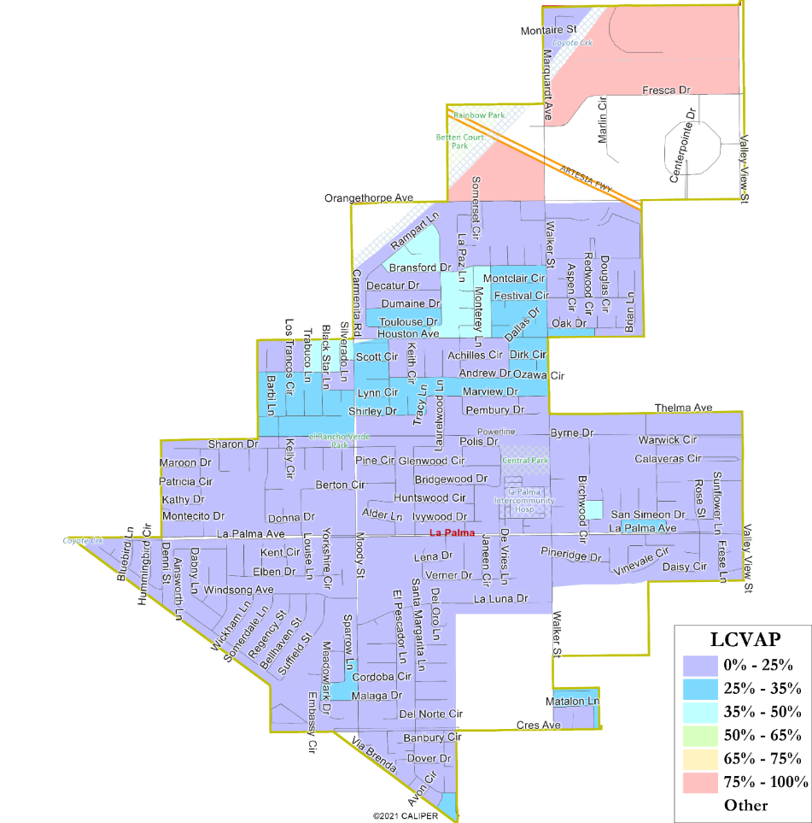
City of La Palma Draft Plan Presentation
Justin Levitt, Vice-President
National Demographics Corporation (NDC)

Slide 2
Districting Timeline
Step | Description
Public Hearing 1 May 3, 2022 | Overview of Process, Outreach Preview, Communities of Interest; Community Feedback.
Public Hearing 2 May 17, 2022 | Map Drawing Criteria, Communities of Interest; Mapping Tools; Community Feedback.
Community Workshop June 21, 2022 | Map Drawing Criteria, Communities of Interest; Mapping Tools; Community Feedback.
Maps Published June 28, 2022 | Maps must be posted 7 days prior to the public hearing at which they are discussed
Public Hearing 3 July 5, 2022 | Hearing to look at the first round of draft maps, discuss and revise the draft maps, and to discuss the election sequence.
Deadline for August 2nd July 21, 2022 | Deadline for new/revised map submissions for the August 2nd Public Hearing
Revised Maps Published July 26, 2022 | Maps must be posted 7 days prior to the public hearing at which they are discussed
Public Hearing 4 August 2, 2022 | Hearing to look at the second round of draft maps, discuss and revise the draft maps, and to discuss the election sequence.
Public Hearing 5/ Selection of Map September 6, 2022 | Introduce ordinance & first reading to establish by-district elections.

Slide 3
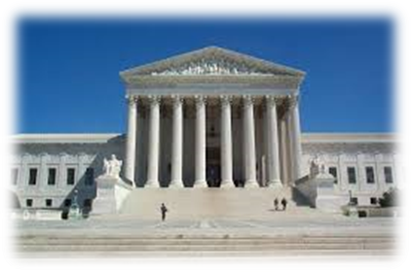
Redistricting Rules and Goals
1. Federal Laws
2. California Criteria for Cities
3. Other Traditional Redistricting Principles
Equal Population
Federal Voting Rights Act
No Racial Gerrymandering
Geographically contiguous
Undivided neighborhoods and “communities of interest” (Socio-economic geographic areas that should be kept together)
Easily identifiable boundaries
Compact (Do not bypass one group of people to get to a more distant group of people)
Prohibited:
“Shall not favor or discriminate against a political party.”
Respect voters’ choices / continuity in office
Future population growth

Slide 4
Draft Maps
All maps are also available on the Interactive Web Viewer

Slide 5
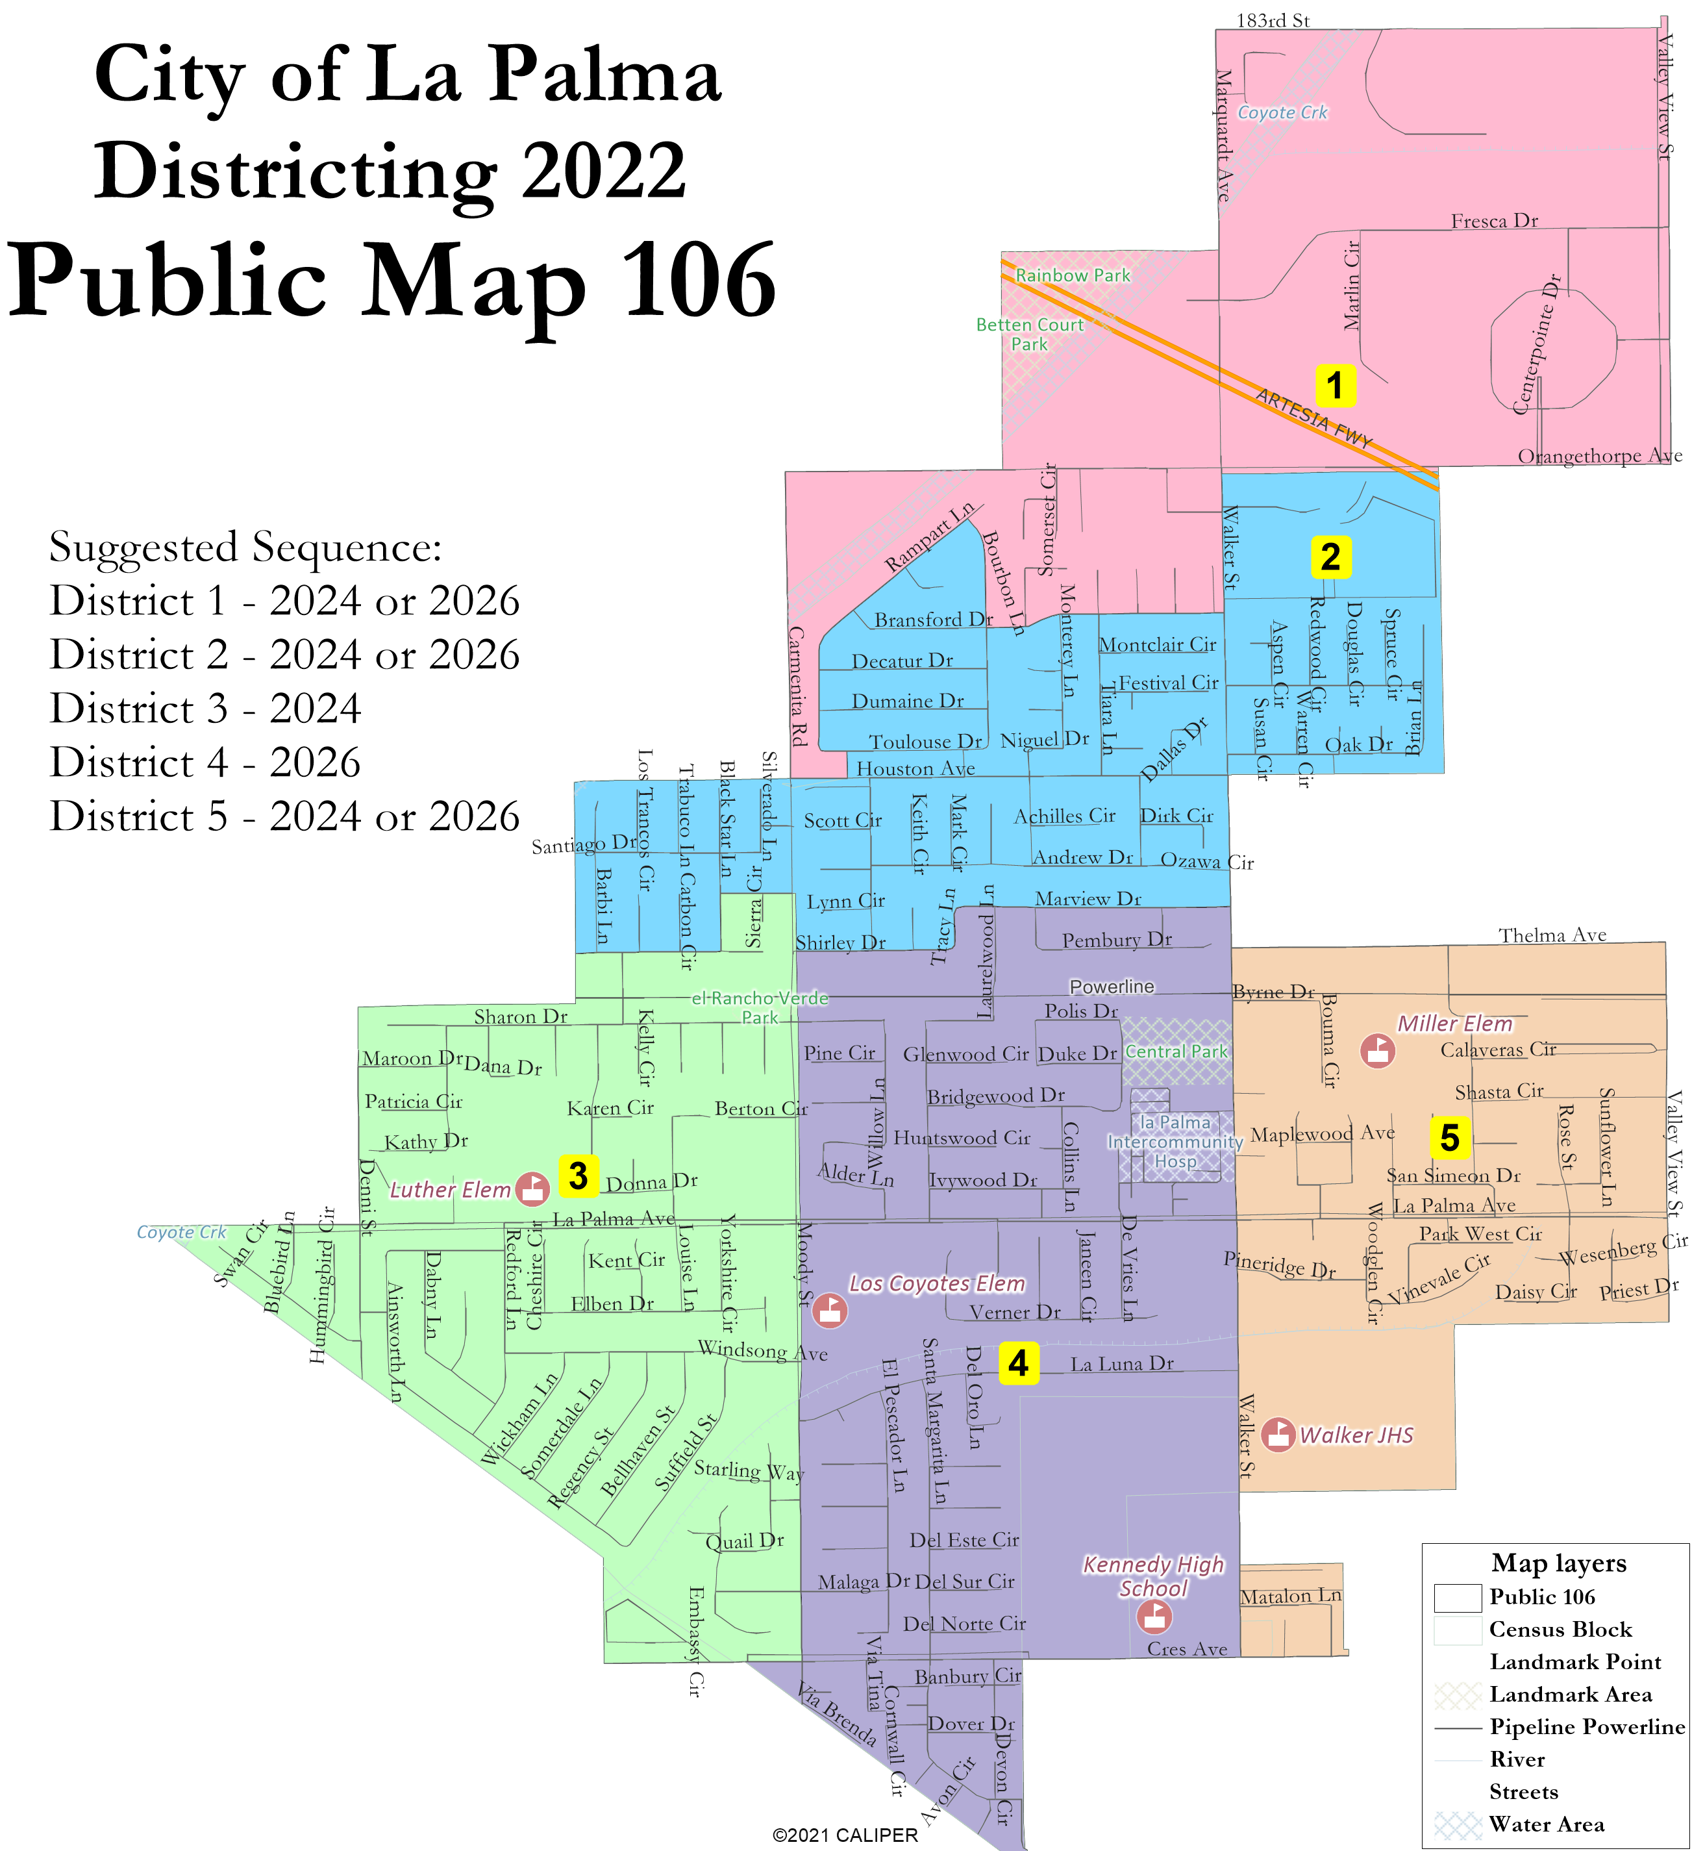
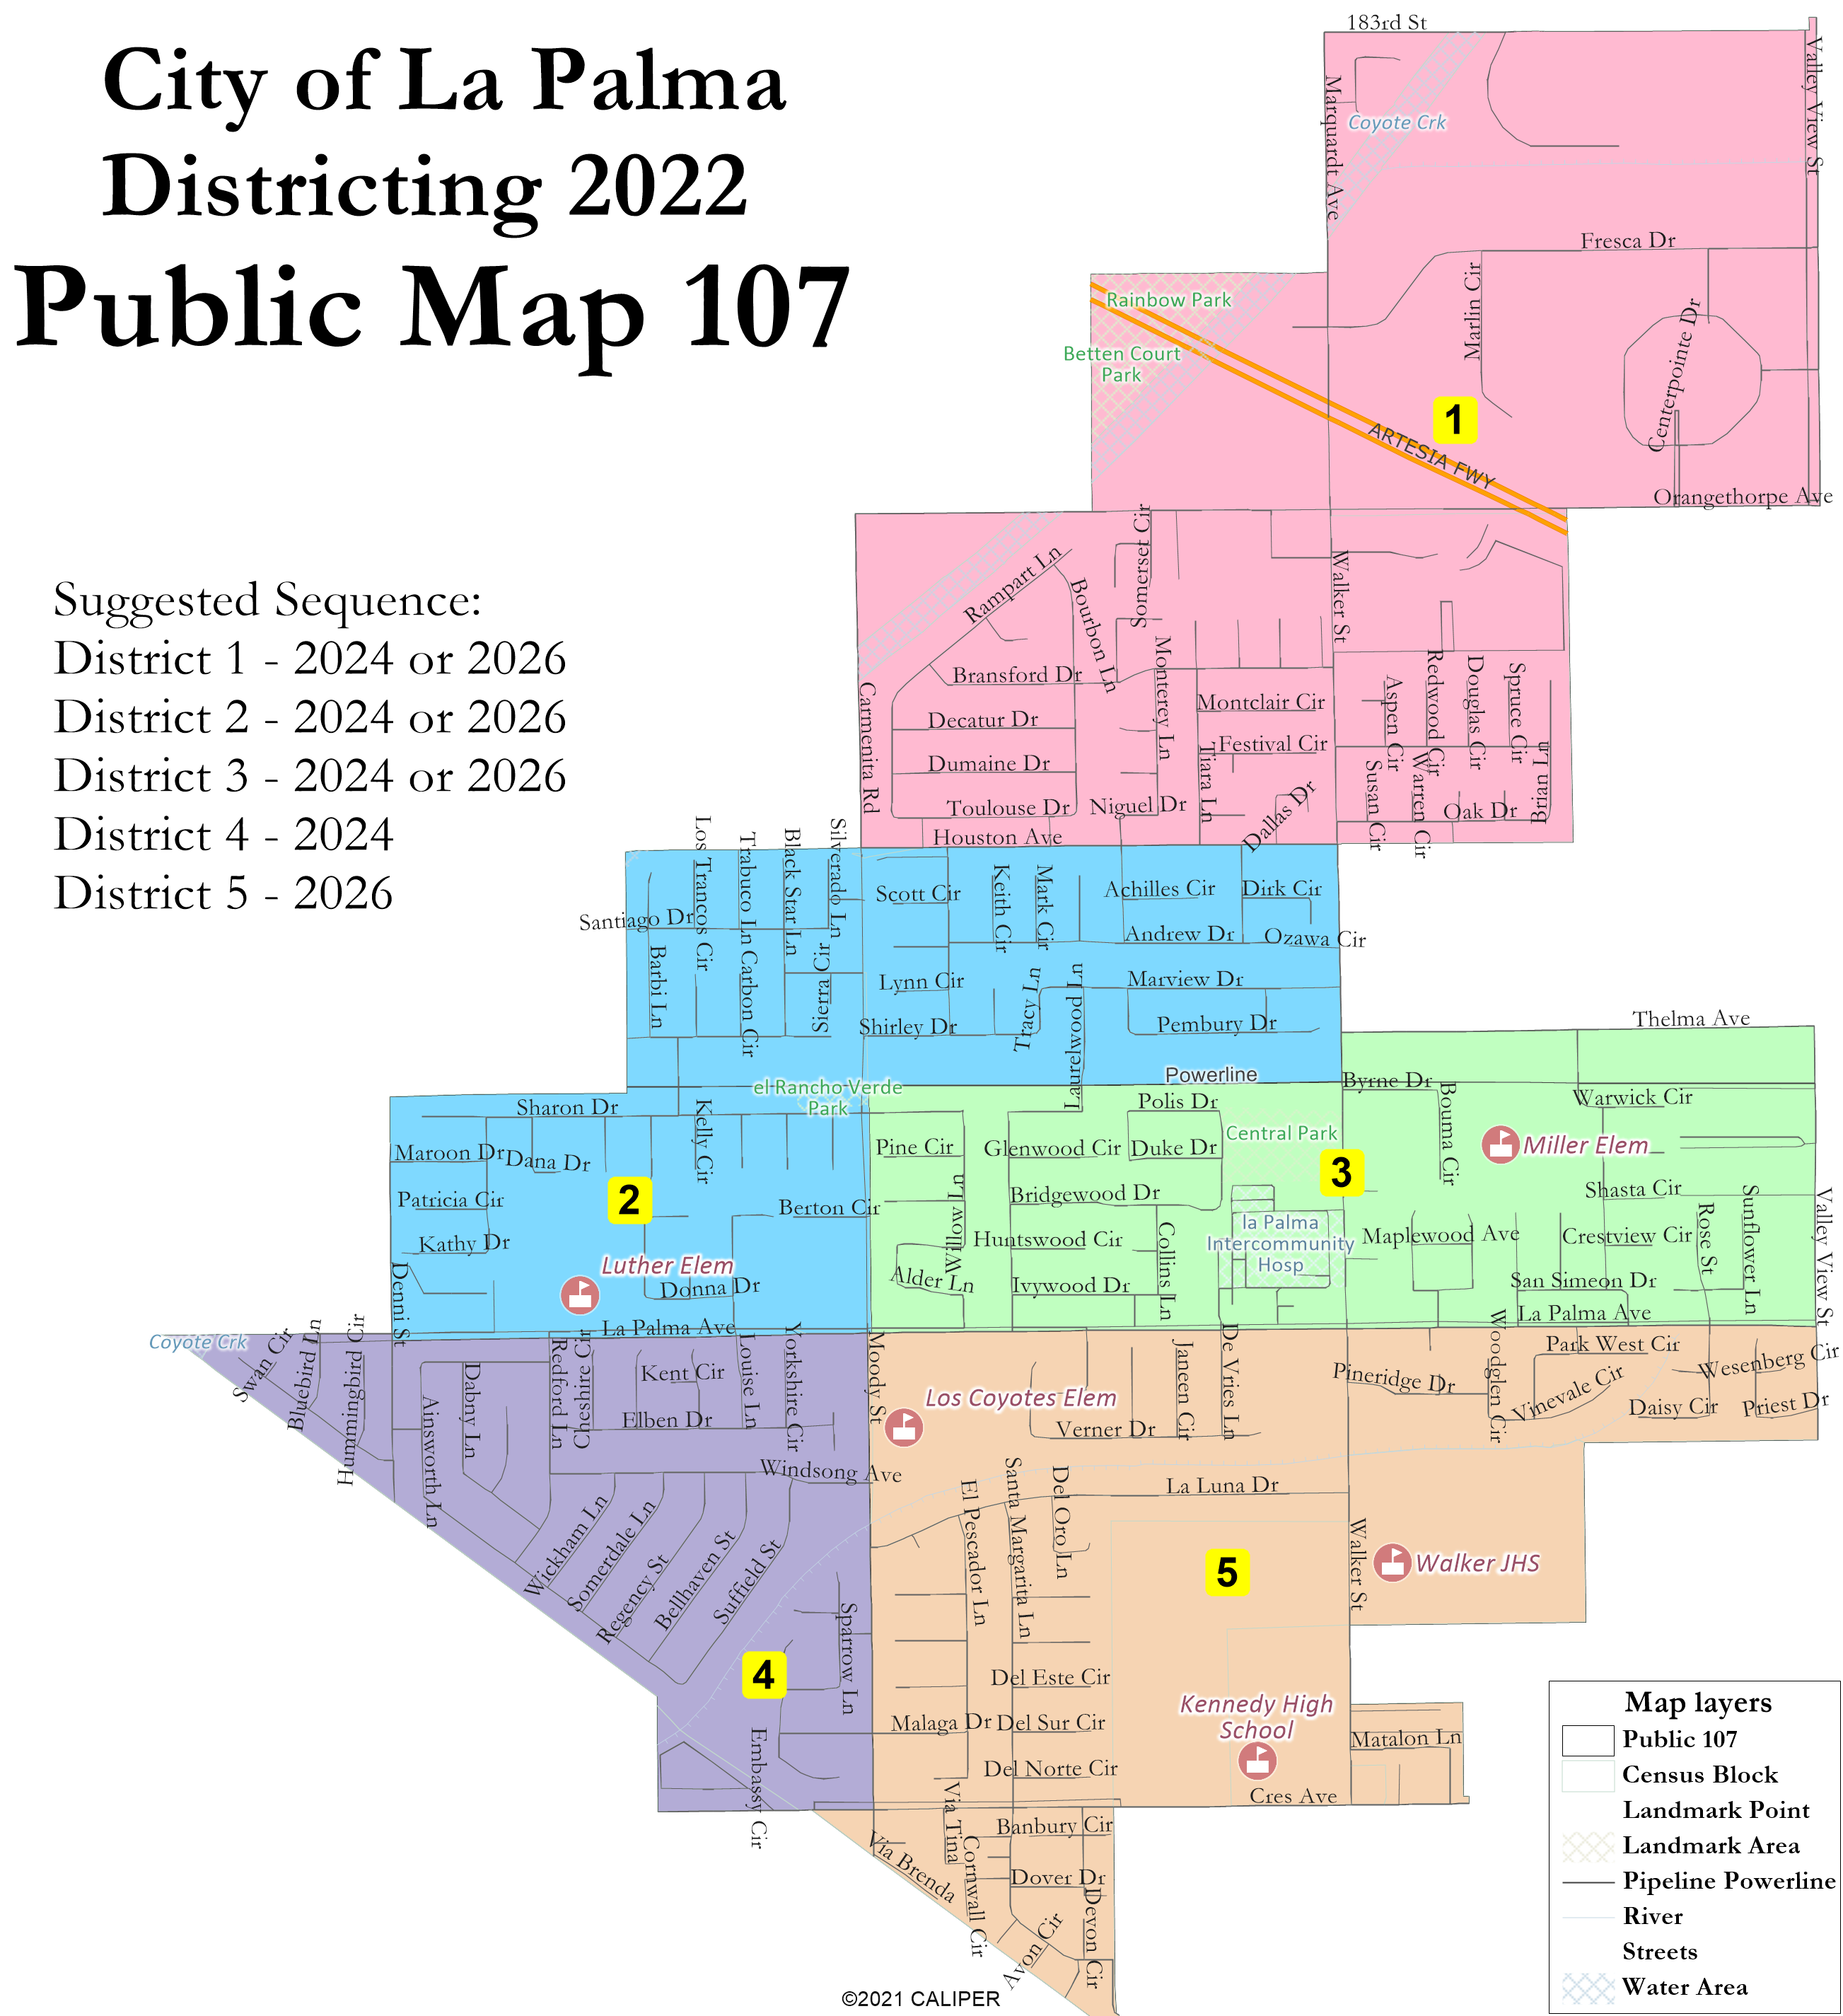
Not balanced & concept maps

Slide 6
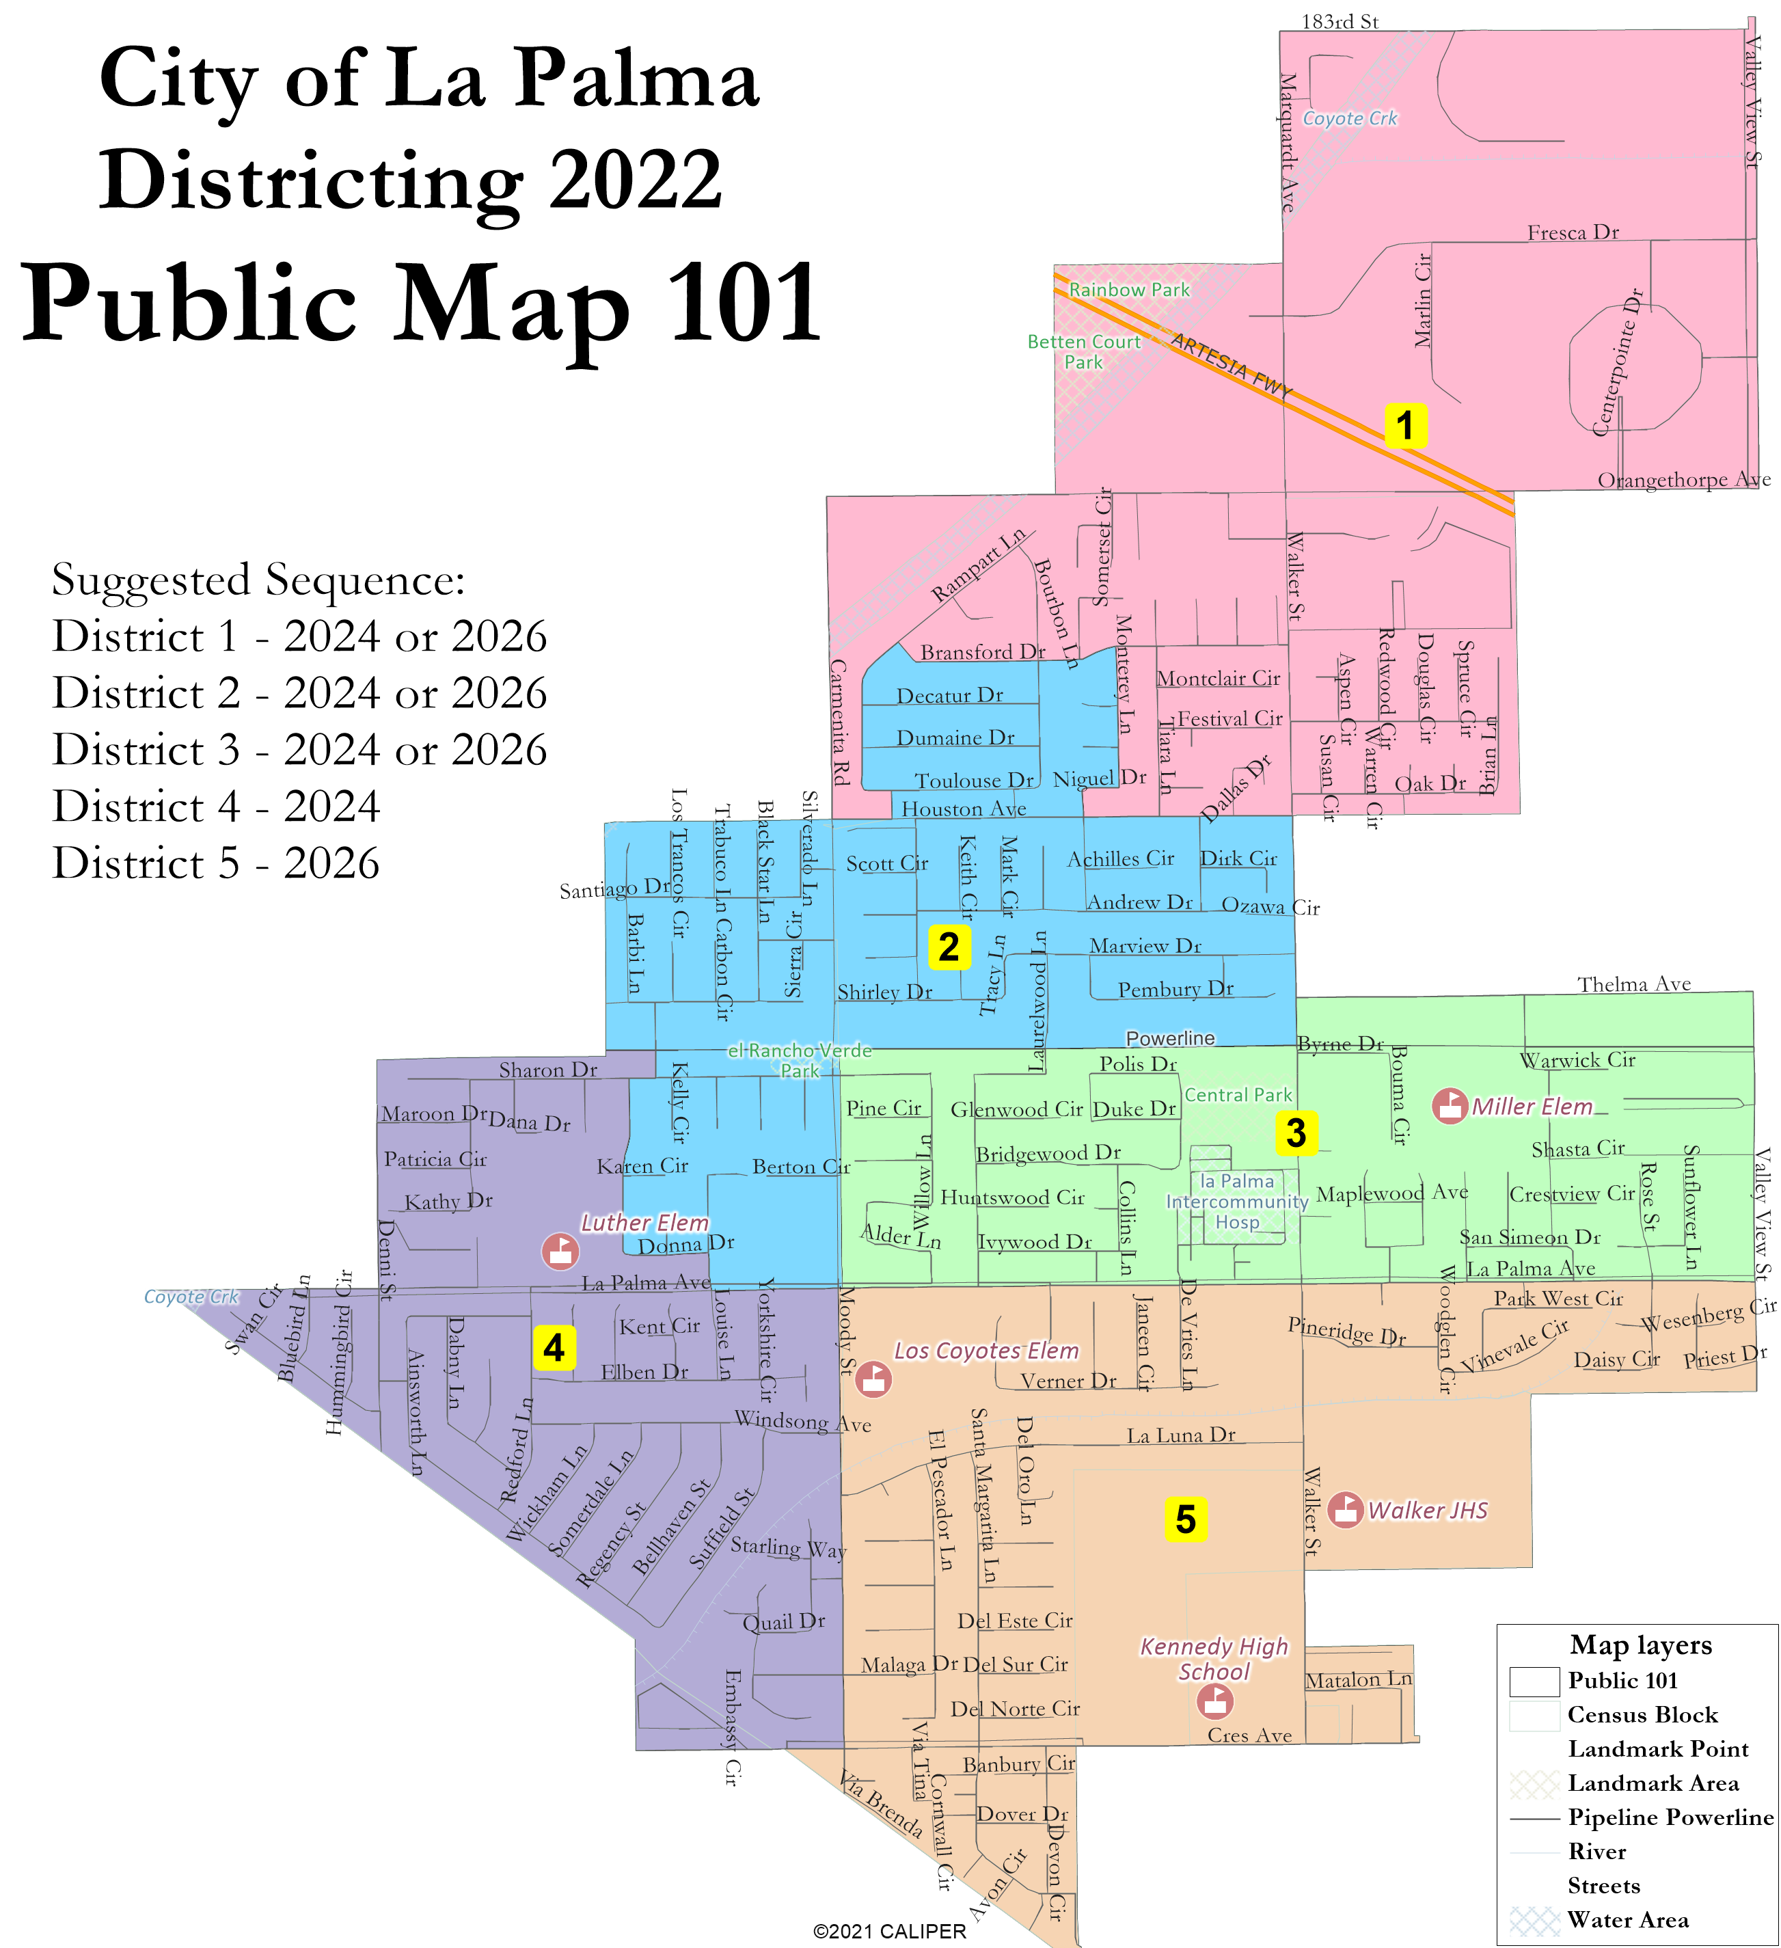
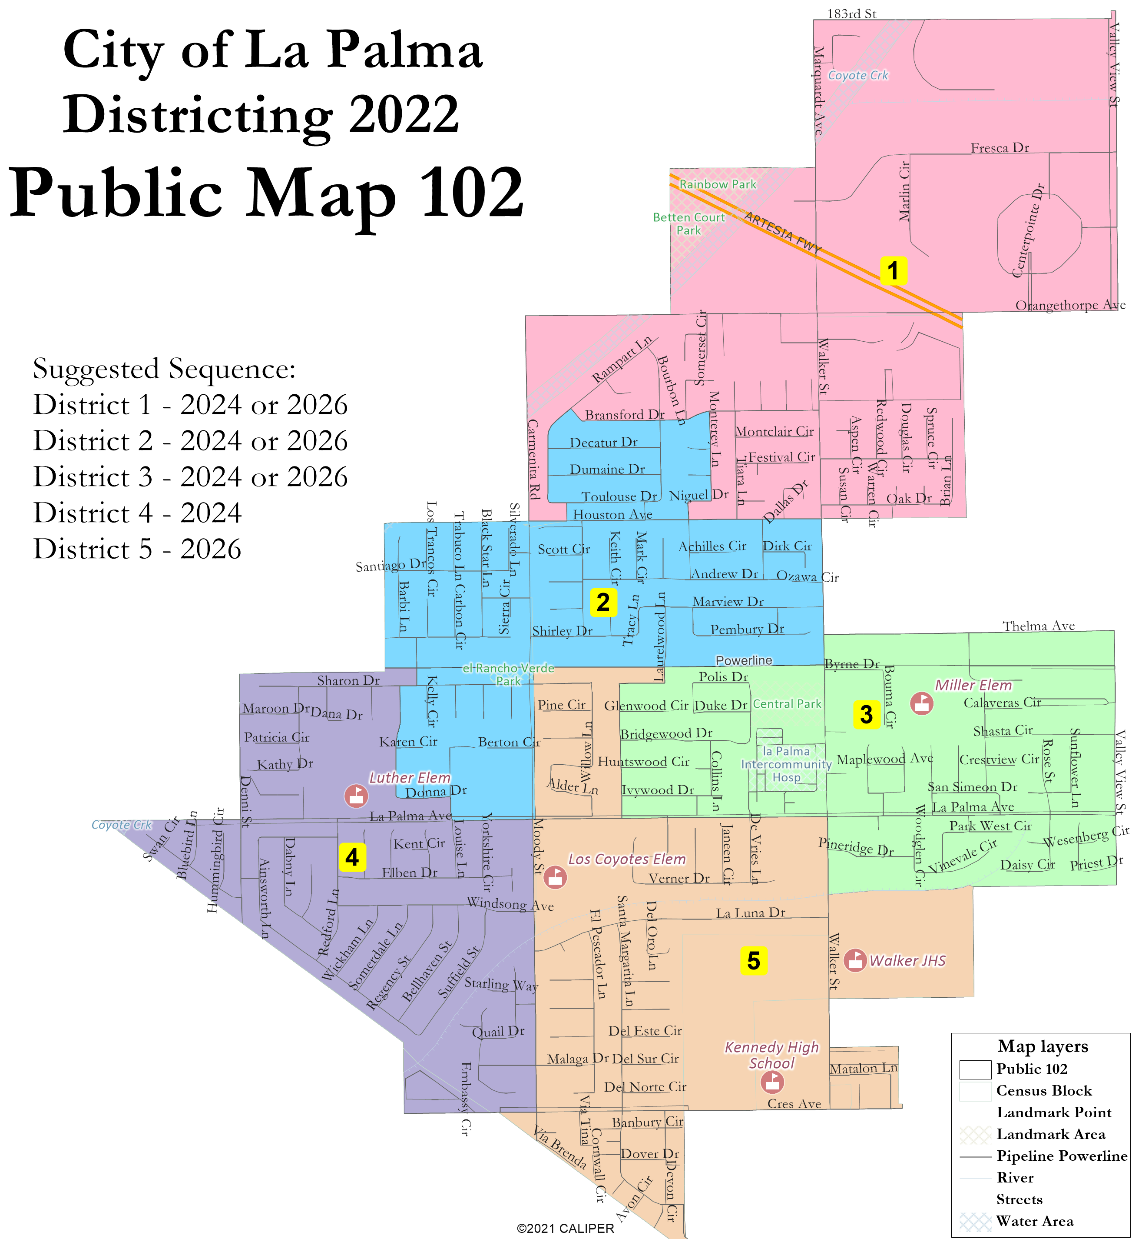
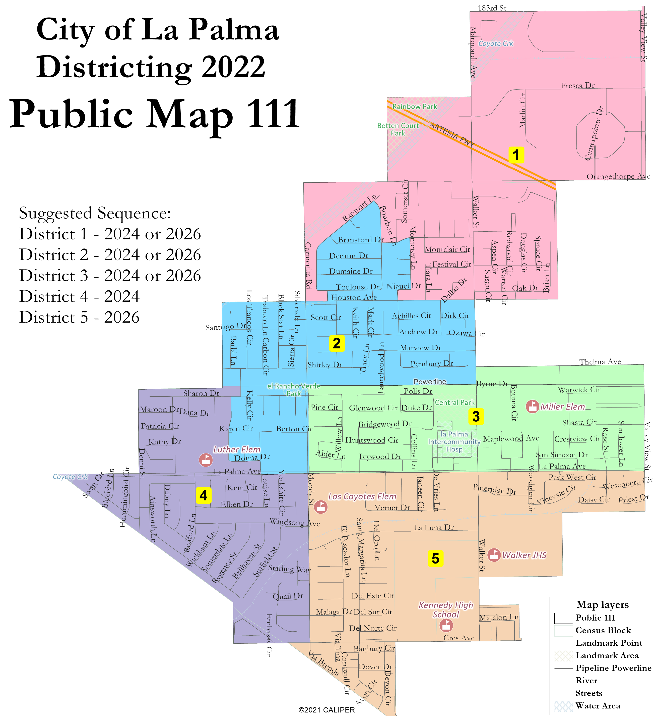
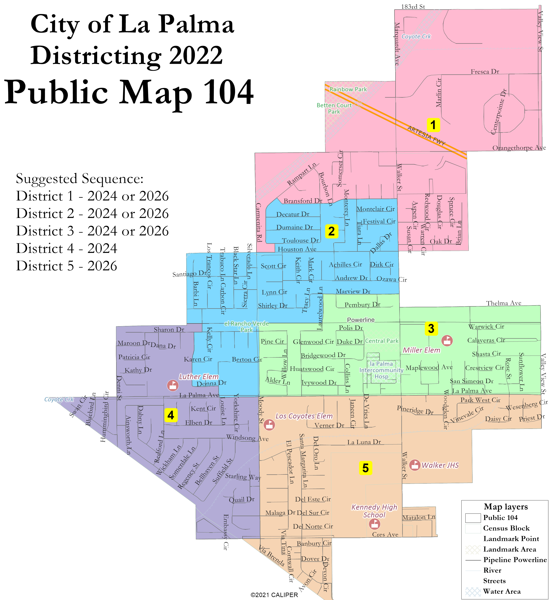
Sutherland Drafts

Slide 7
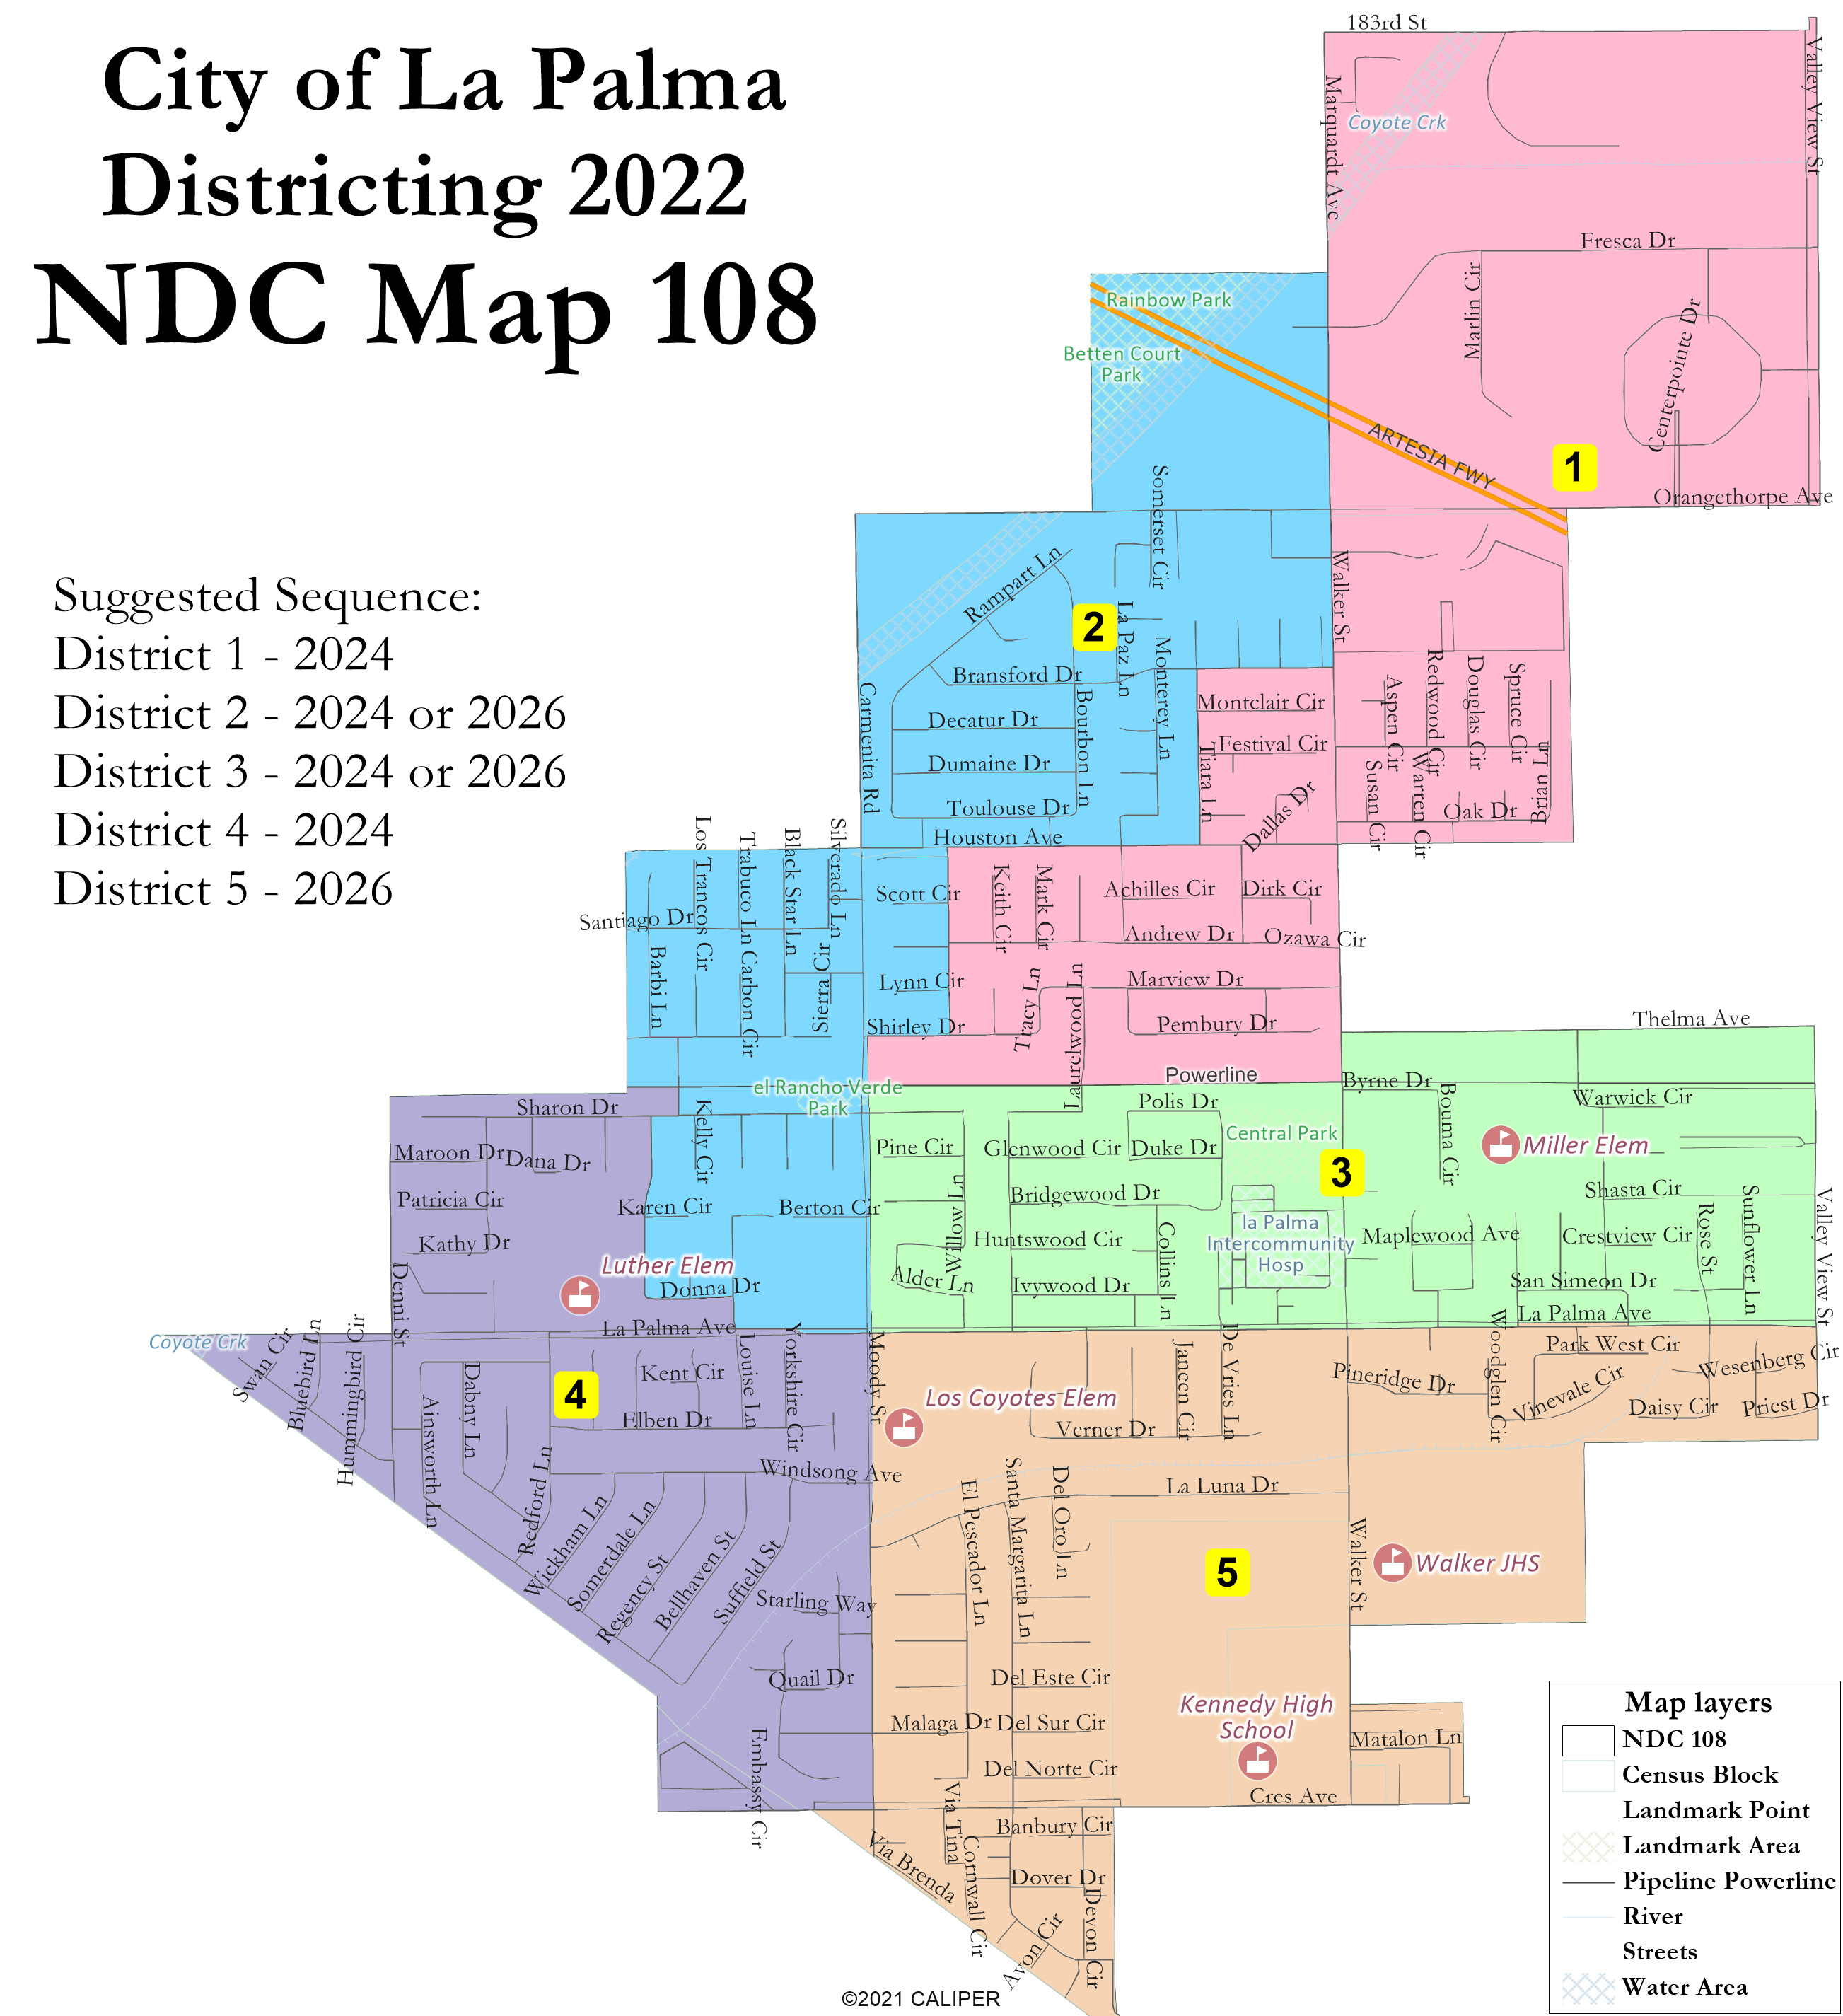
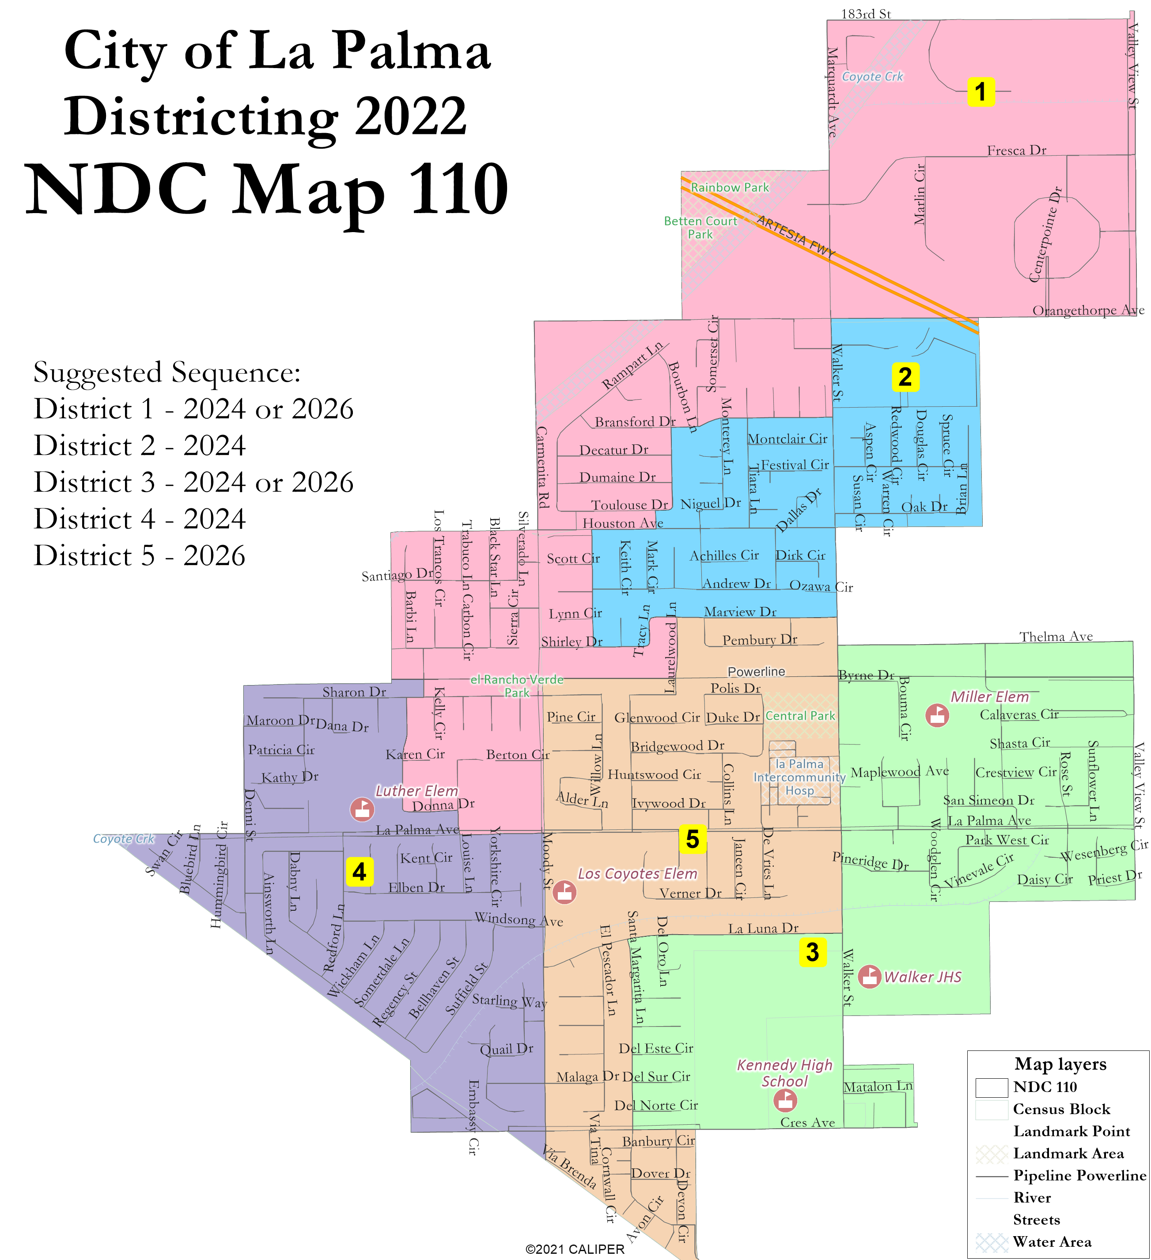
Area north of Houston split evenly

Slide 8
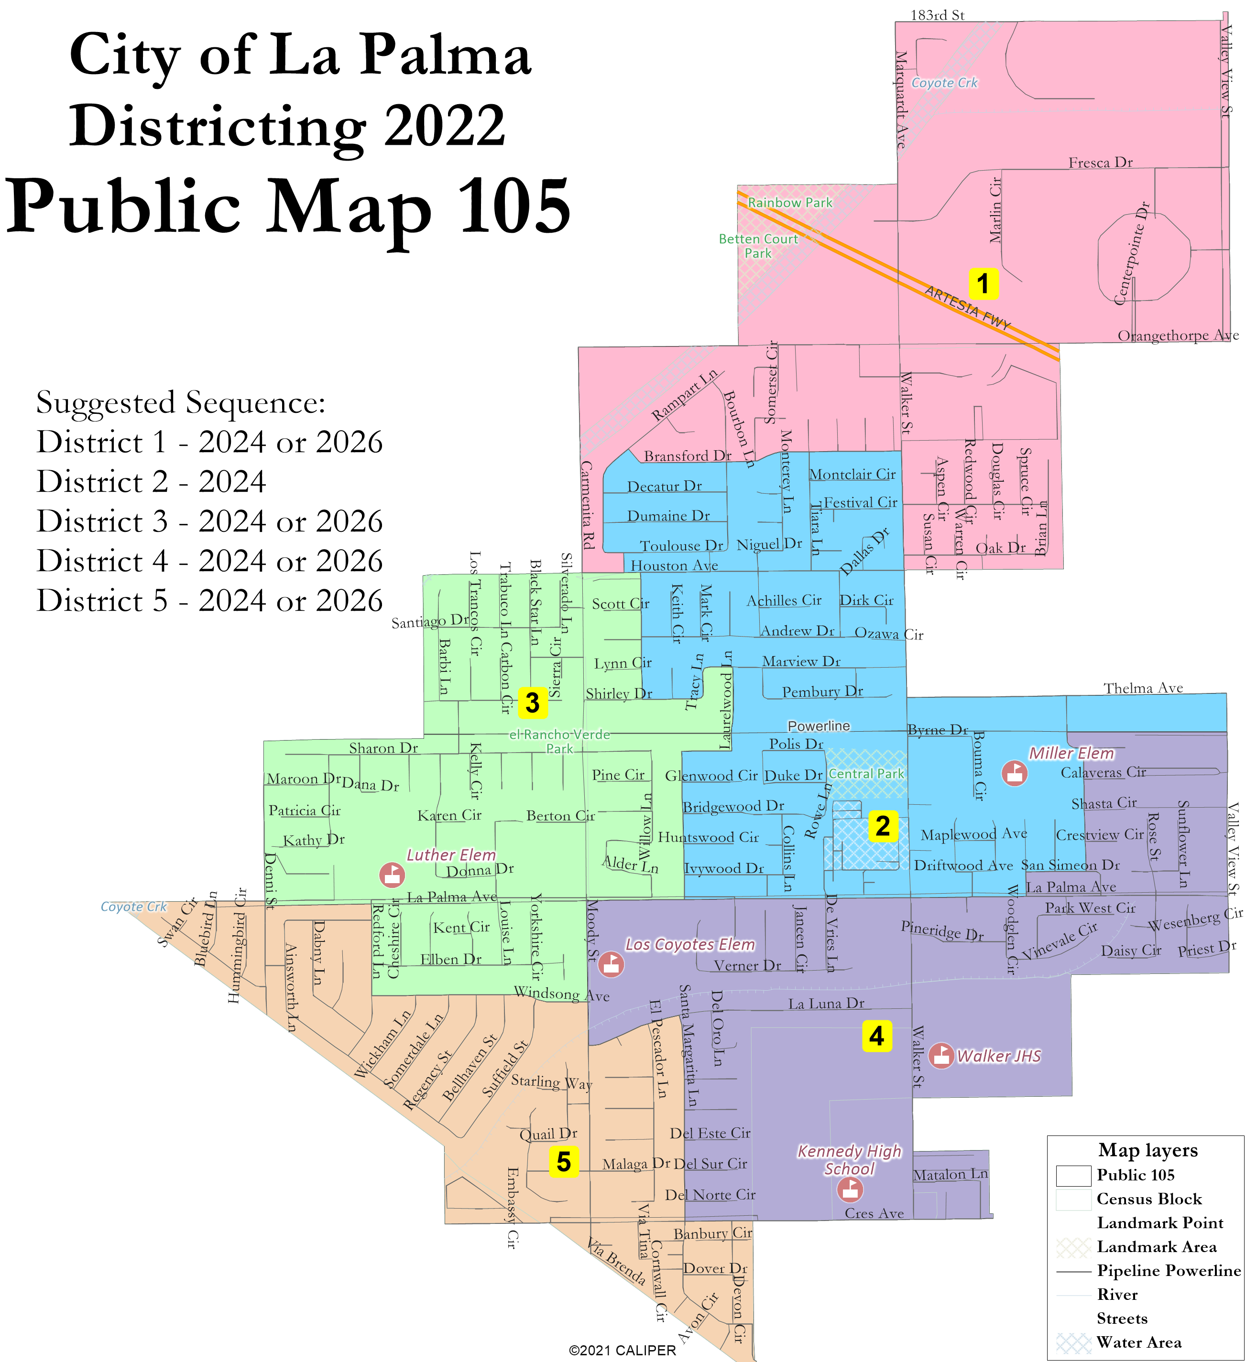
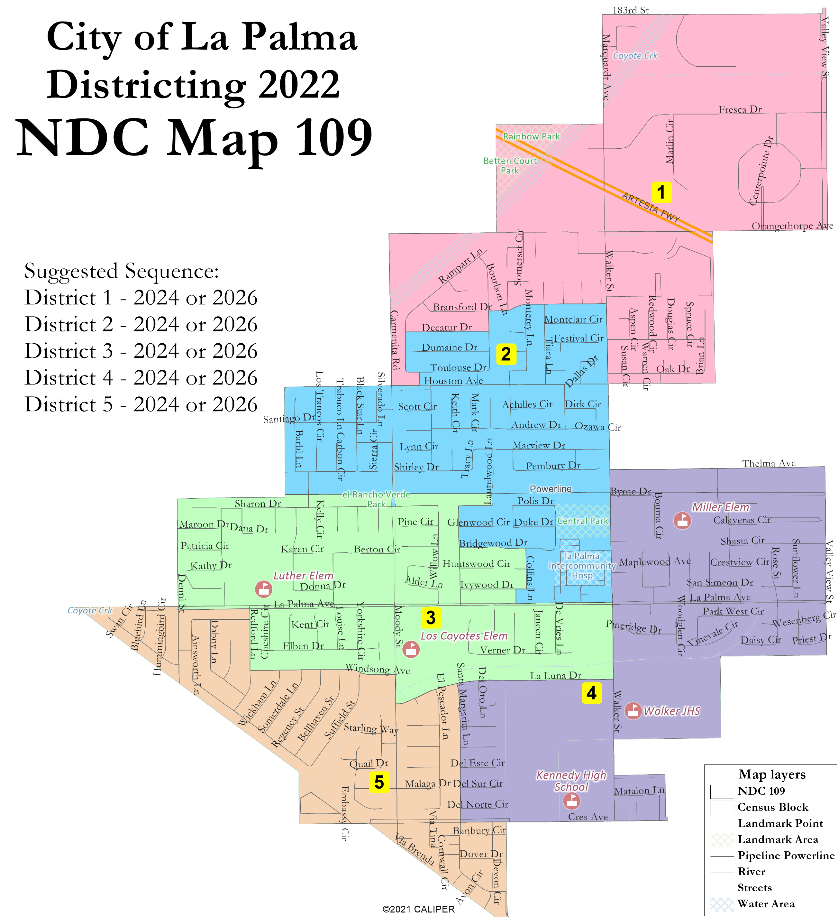
Central D2/South D5

Slide 9
Public Hearing & Discussion
What do you like or dislike about each draft map?
What requests for changes or revisions do you want to see?
Map changes will require 7 days for posting
Are there any maps that can be eliminated, or is there a preference for 2-3 “focus” maps?
Any questions about the mapping tools?

Slide 10
Share Your Thoughts
Website
www.CityofLaPalma.org/Districting
Phone
(714) 690-3358
Email
Districting@CityofLaPalma.org

